Slide 1

PLAGIARISM CHECKER

Slide 2

A Project for Programming Fundamentals Lab
FAST NUCES Peshawar
Team Members:
Mohsin Ali
Amna Maqsood
Momina Ahmad

Slide 3

Introduction to
the Project
Plagiarism is a major issue in academic institutions.
Manual checking is slow, inaccurate, and exhausting.
Our project provides an automated, reliable, and fast plagiarism detection system.
Works for both:
Text documents
Programming code files

Slide 4

Problem Statement
Students often copy assignments, code, and reports.
Teachers spend hours comparing documents manually.
Existing tools:
Expensive
Work only for text or only for code
Not customizable
There is a need for a simple, fast, and unified plagiarism checker for both text and code.

Slide 5

Proposed Solution
A dual-mode plagiarism checker that supports:
✔ Text File Plagiarism
✔ Code Plagiarism
Provides:
  Preprocessing
  Tokenization
  Similarity measurement
  Automatic comparison
  User-friendly reporting

Slide 6
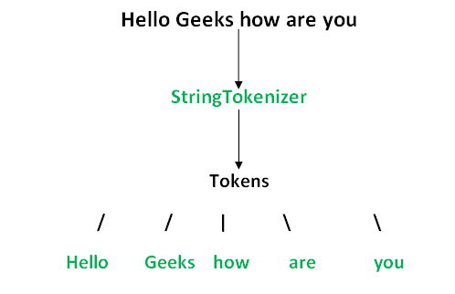
System Architecture
Module A – Preprocessing & File Handling
Handles .txt, .c, .pdf, .docx
Cleans text (lowercase, remove punctuation, spaces)
Normalizes code (remove comments, placeholders)
Module B – User Interface & Reporting
Menu system
Displays results
Generates reports
Module C – Algorithms & Integration
Tokenization
N-gram generation
Final similarity calculation

Slide 7
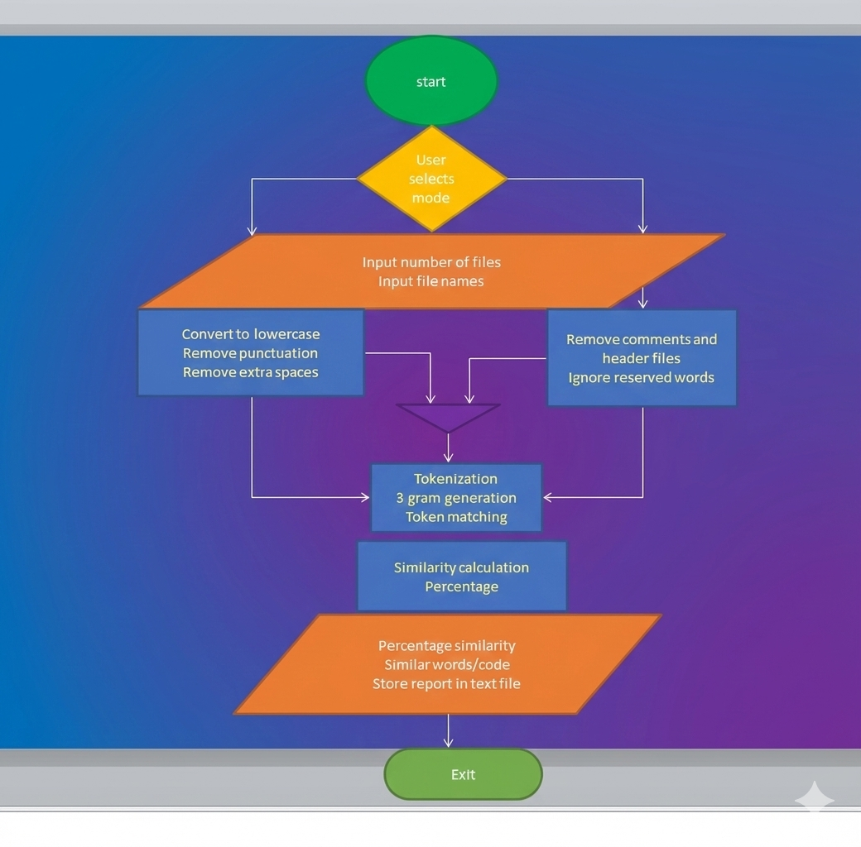

Slide 8
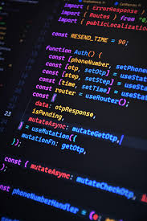
Technologies Used
Language: C
Libraries:
  stdio.h
  string.h
  ctype.h
  math.h
Algorithms:
  N-gram
Tools:
  pdftotext
  docx2txt

Slide 9
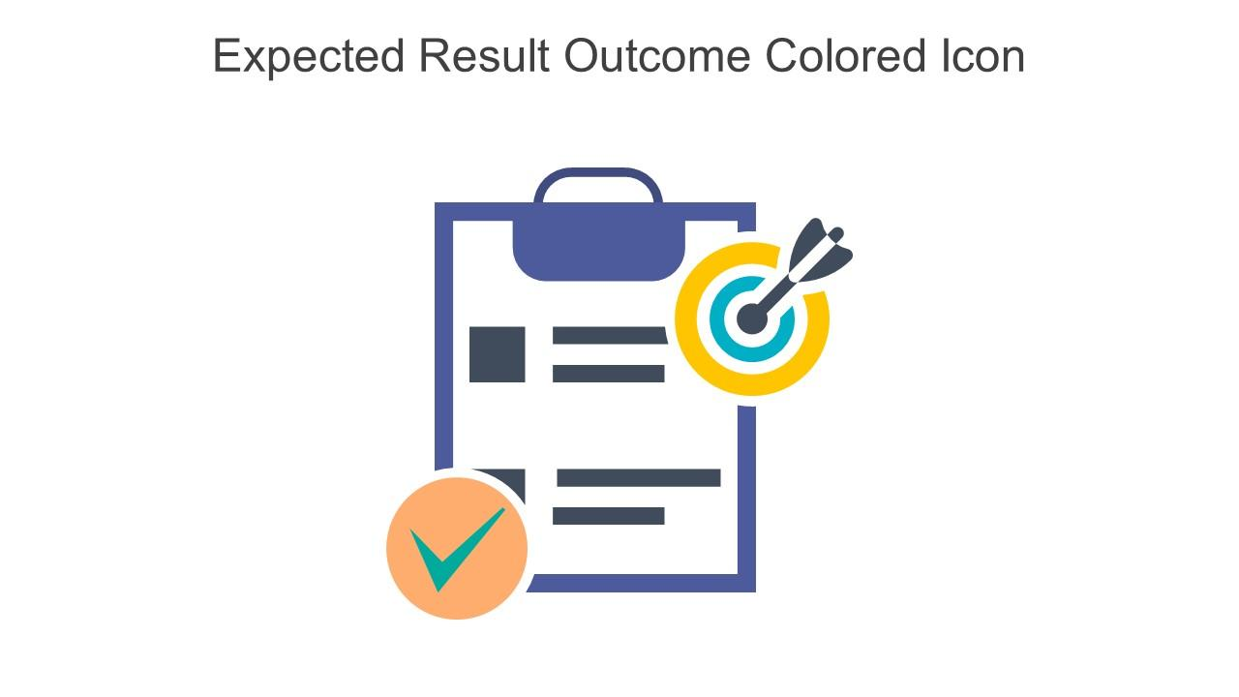
Expected
Outcomes
Detect plagiarism in both text and code
Provide accurate similarity scores
Reduce teachers’ workload
Encourage originality among students
Easy to extend, maintain, and deploy

Slide 10

Limitations of the
System
Paraphrased text with different wording may not be detected
Code plagiarism detection may miss logic-level similarity
Cannot fully detect plagiarism in images or scanned PDFs
Accuracy depends on preprocessing and tokenization quality

Slide 11
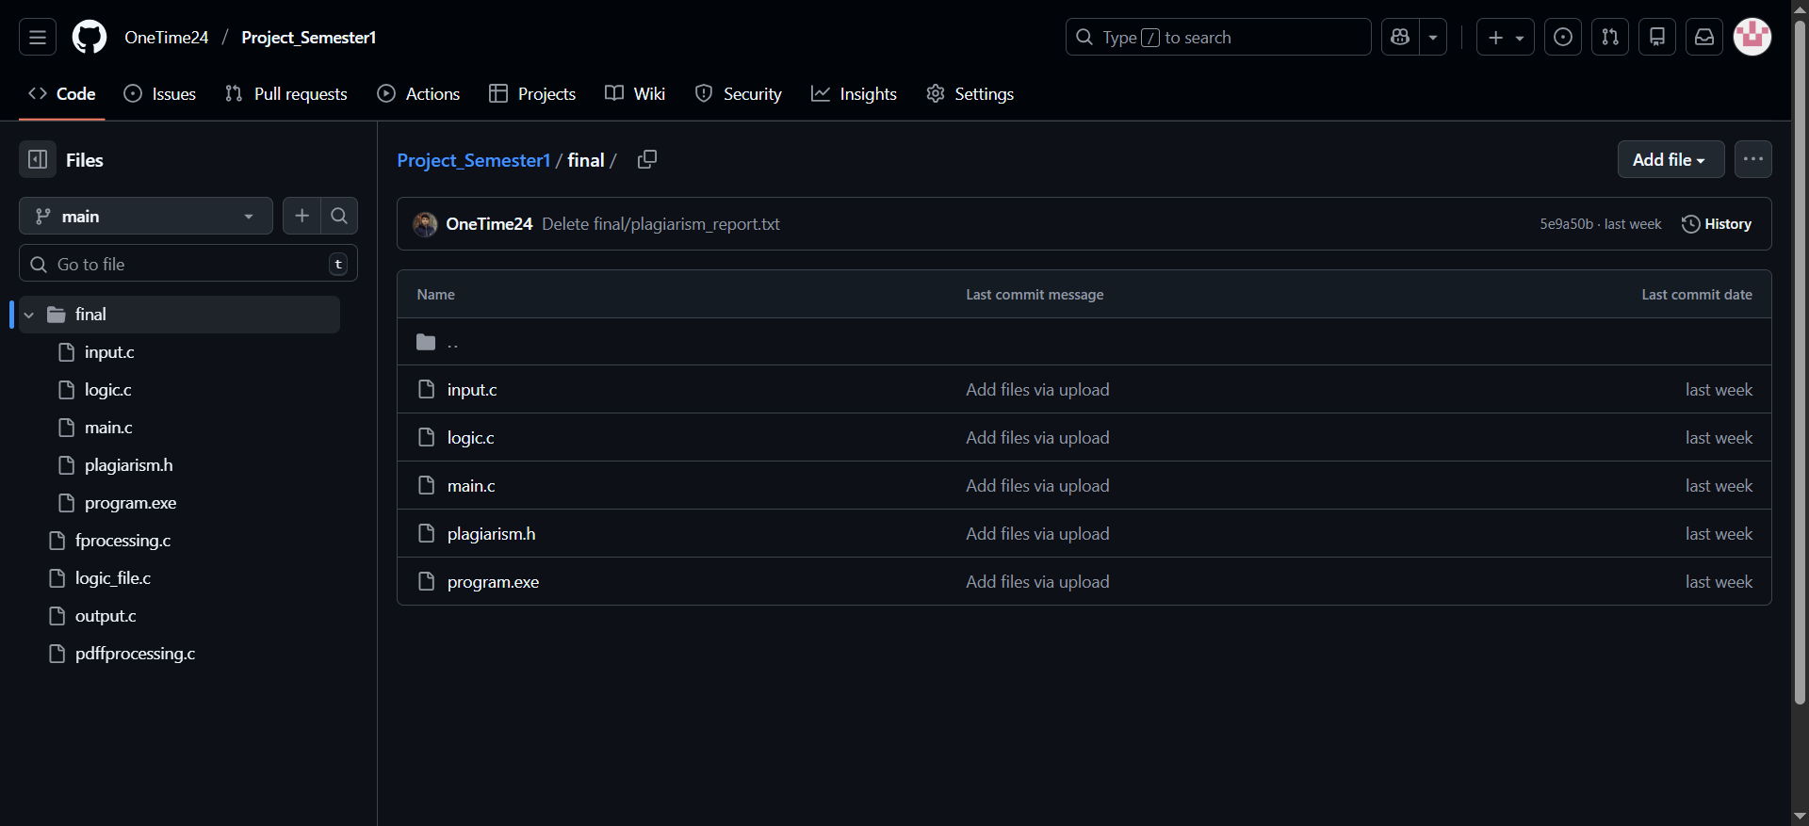
Collaboration
GitHub was used to manage and track project progress
Each team member worked on separate modules
Enabled easy collaboration and conflict prevention
Maintained version history and backups
Simplified integration of modules into final system

Slide 12


